Slide 1
Aqar
Presenter : Jawaher Aljulaify – Jamila Alharbi
Instructor: Dr. Mejdal Alqahtani

Slide 2
Introduction
Due to the information gap about house prices and the difference in house prices from one neighborhood to another, the individual may face a problem estimating house prices and may be subject to deception by real estate owners.
Therefore, we will build a model that predicts house prices in various neighborhoods in Saudi Arabia's capital Riyadh based on several features.

Slide 3
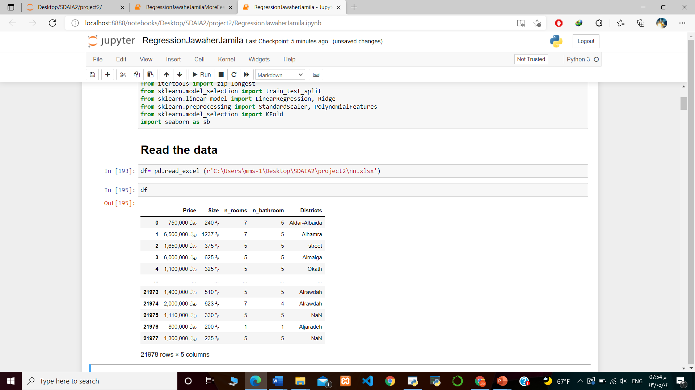
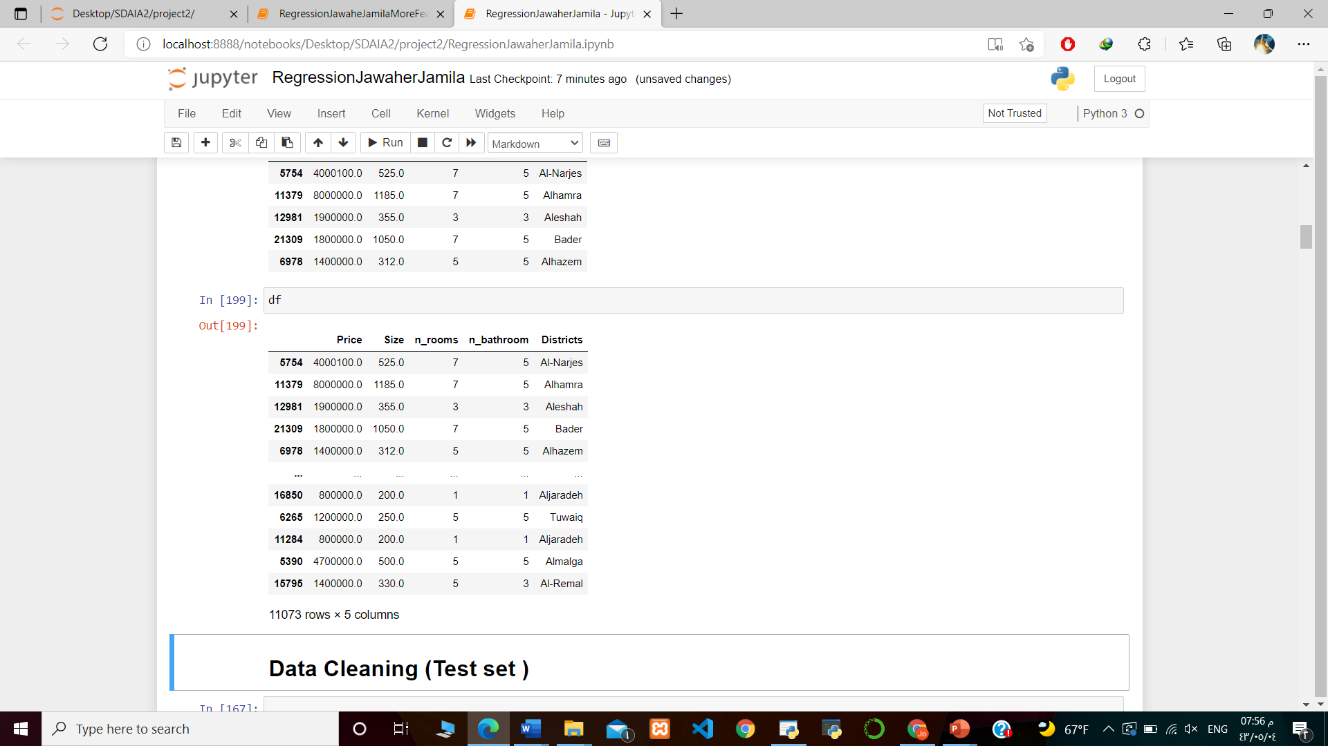
Data Structure
We have 21978 rows and 5 columns
.
We have 11073 rows and 5 columns
After cleaning In Training set
.

Slide 4
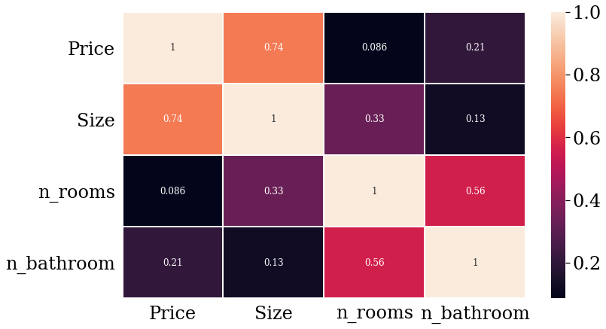
Correlation

Slide 5
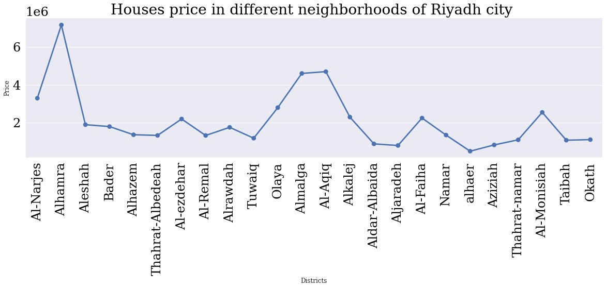

Slide 6
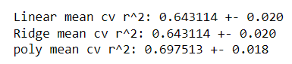
Cross Validation
Before Converting categorical values

Slide 7
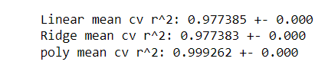
Cross Validation
After Converting categorical values
Then we have 11073 rows and 27 columns

Slide 8
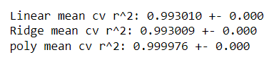
Cross Validation
After Adding Log for Price

Slide 9
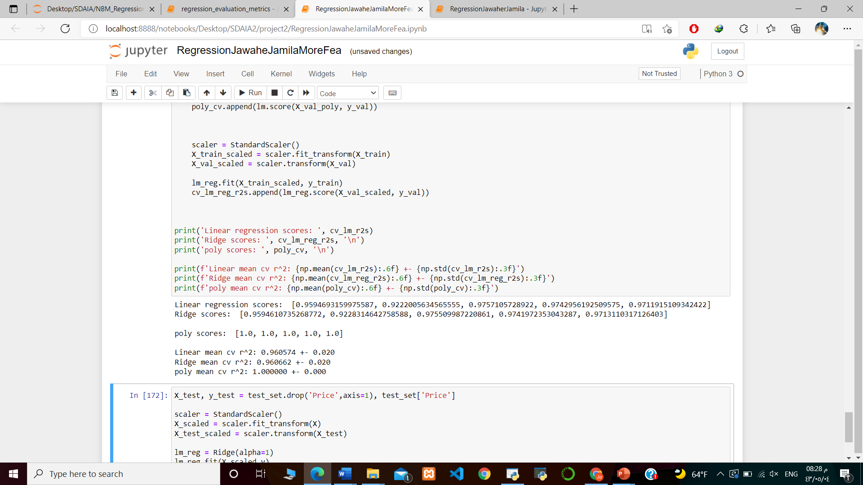
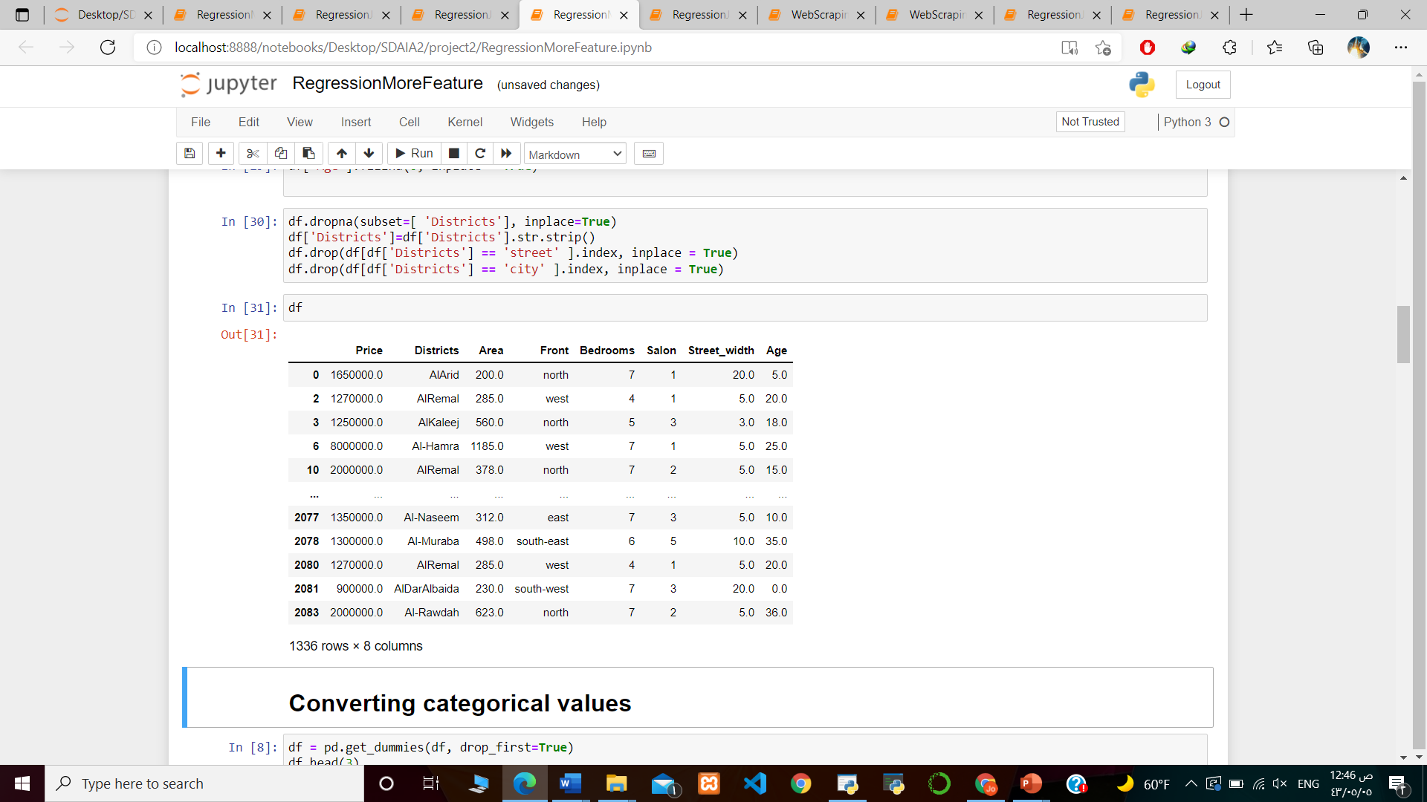
Cross Validation
After Adding more feature in another data set
2084 rows and 9 columns

Slide 10
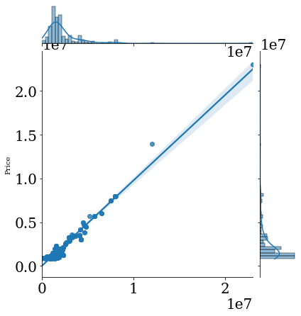

Slide 11
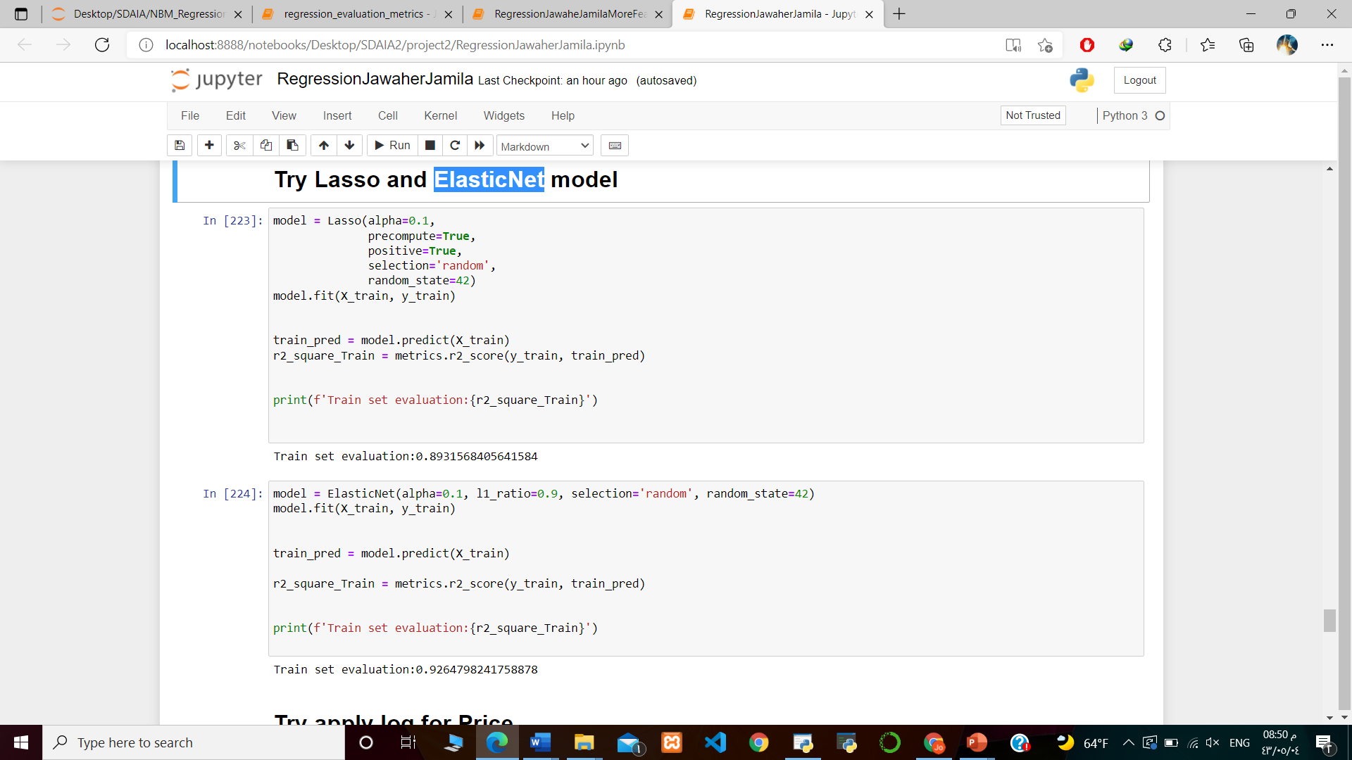
Lasso
ElasticNet

Slide 12
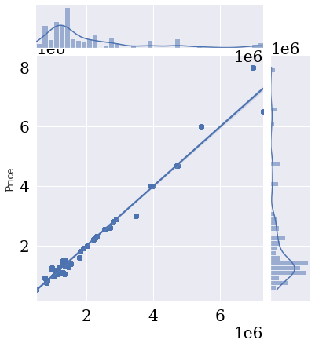
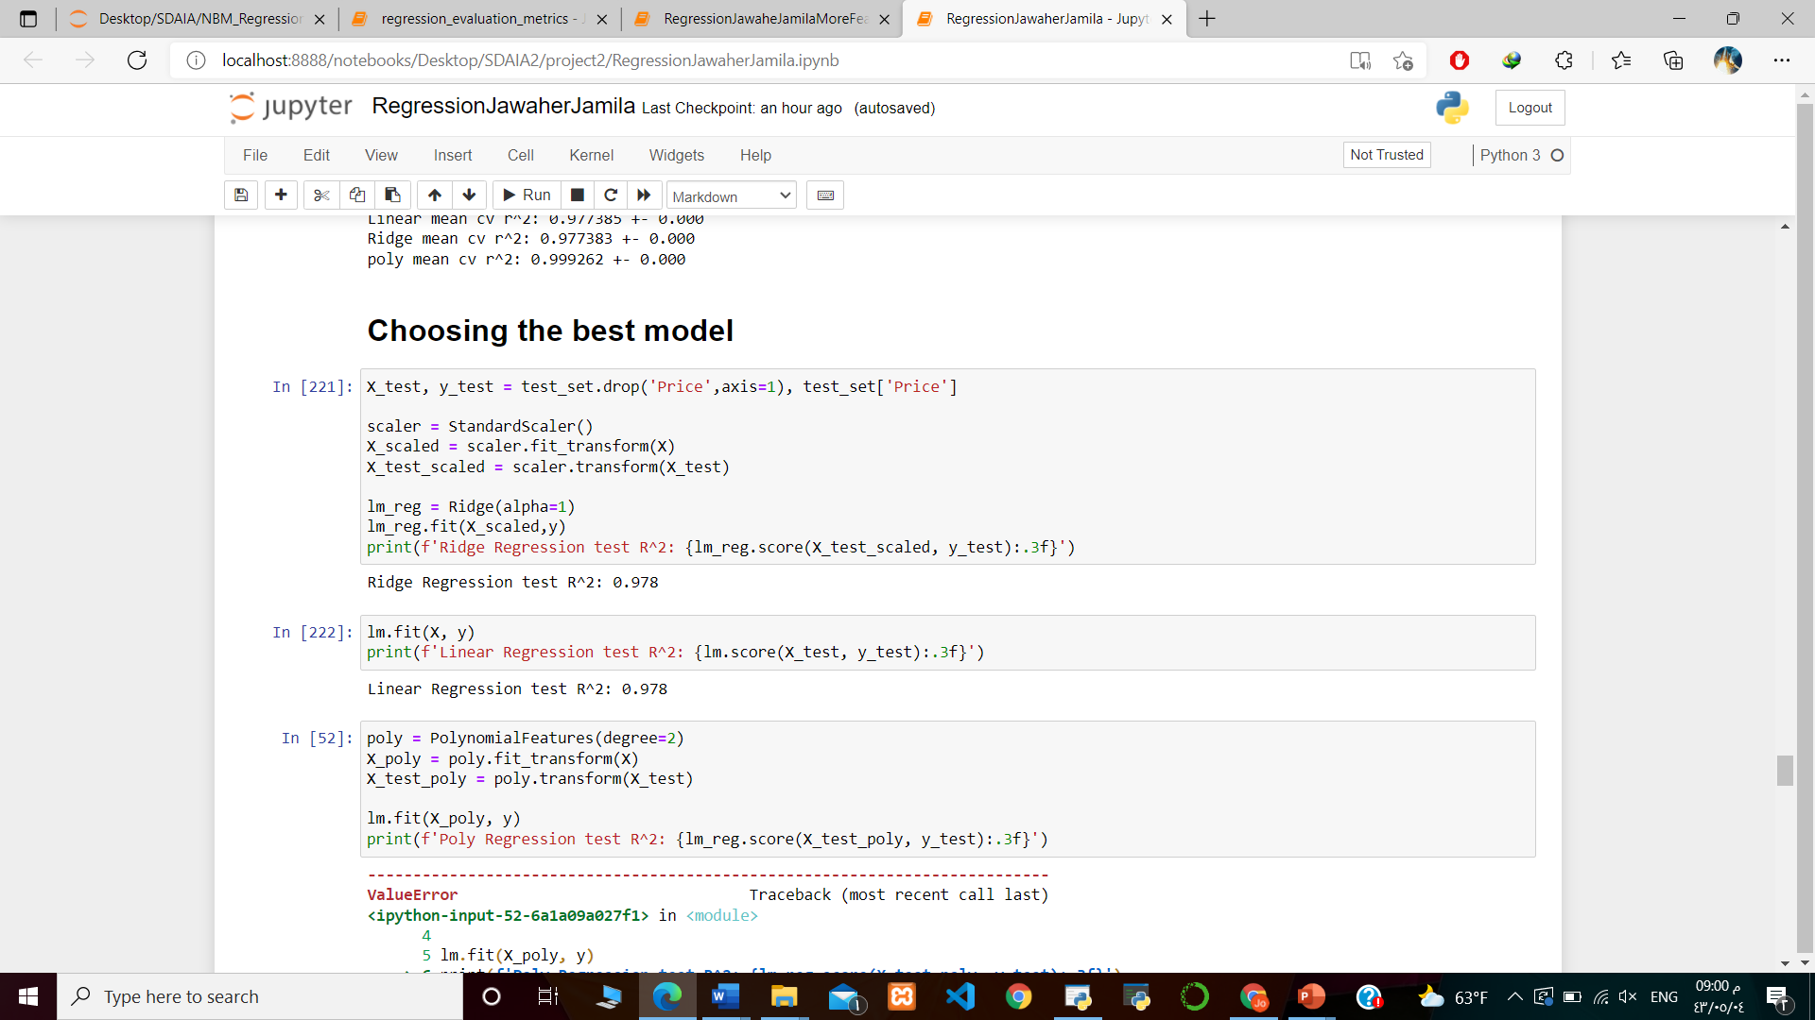
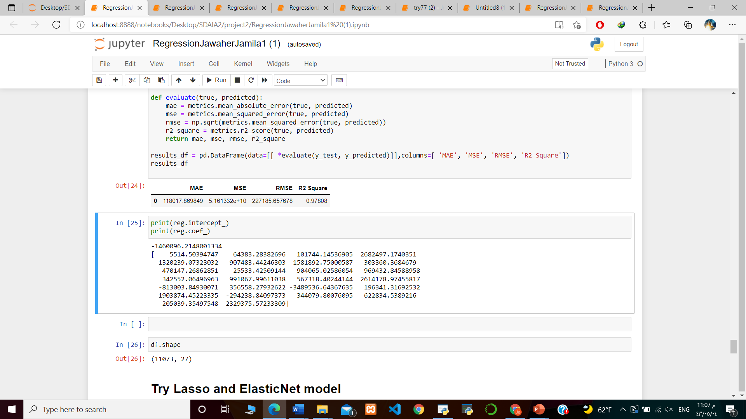
Select final model
Linear regression

Slide 13
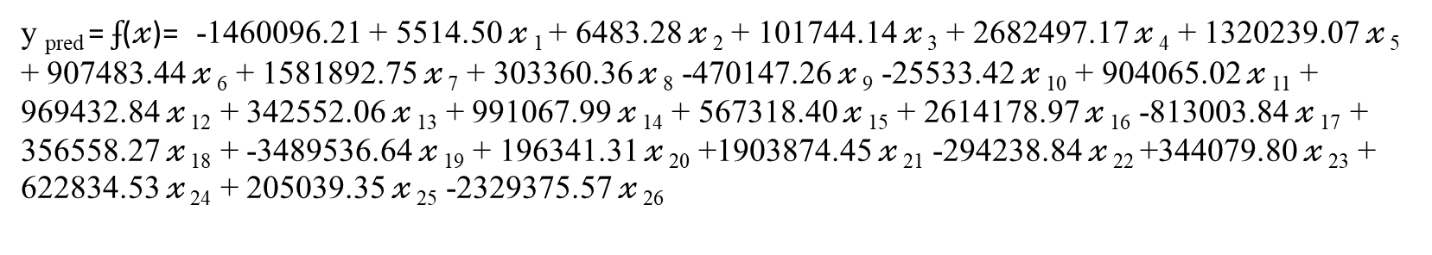
Select final model
Linear regression
y _{pred} = $ʄ$(𝓍)= -1460096.21 + 5514.50 𝓍 ₁ + 6483.28 𝓍 ₂ + 101744.14 𝓍 ₃ + 2682497.17 𝓍 ₄ + 1320239.07 𝓍 ₅ + 907483.44 𝓍 ₆ + 1581892.75 𝓍 ₇ + 303360.36 𝓍 ₈ -470147.26 𝓍 ₉ -25533.42 𝓍 ₁₀ + 904065.02 𝓍 ₁₁ + 969432.84 𝓍 ₁₂ + 342552.06 𝓍 ₁₃ + 991067.99 𝓍 ₁₄ + 567318.40 𝓍 ₁₅ + 2614178.97 𝓍 ₁₆ -813003.84 𝓍 ₁₇ + 356558.27 𝓍 ₁₈ + -3489536.64 𝓍 ₁₉ + 196341.31 𝓍 ₂₀ +1903874.45 𝓍 ₂₁ -294238.84 𝓍 ₂₂ +344079.80 𝓍 ₂₃ + 622834.53 𝓍 ₂₄ + 205039.35 𝓍 ₂₅ -2329375.57 𝓍 ₂₆

Slide 14
Conclusion
We have made a model capable of predicting house prices at a high accuracy, which will help everyone who wants to settle in the capital, Riyadh.
We will develop the model with more features by increasing the number of rows to be an excellent model

Slide 15
THANK YOU

